Slide 1
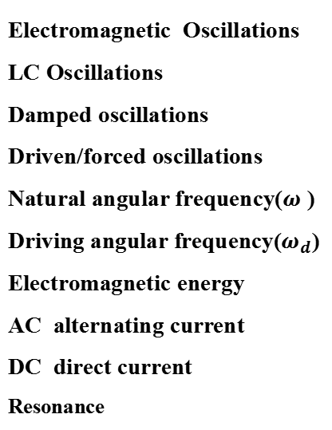
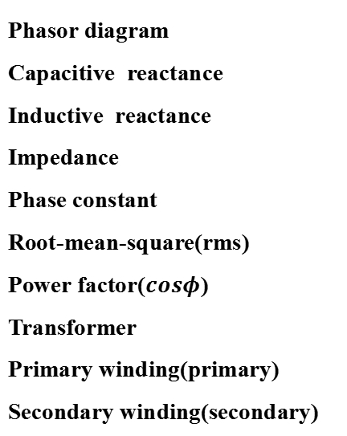
Review of Ch31
Key words
Electromagnetic Oscillations
LC Oscillations
Damped oscillations
Driven/forced oscillations
Natural angular frequency($ω$ )
Driving angular frequency($ω_{d}$)
Electromagnetic energy
AC alternating current
DC direct current
Resonance
Phasor diagram
Capacitive reactance
Inductive reactance
Impedance
Phase constant
Root-mean-square(rms)
Power factor($cosφ$)
Transformer
Primary winding(primary)
Secondary winding(secondary)
Ch31-1

Slide 2

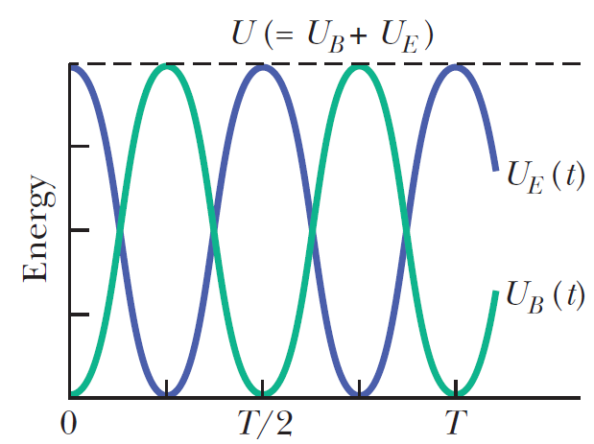
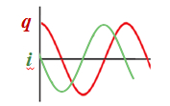
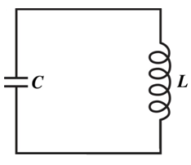

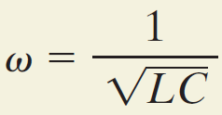
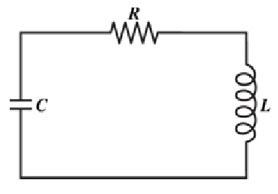
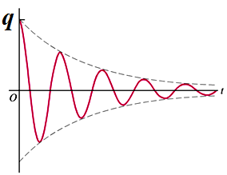



Review of Ch31
LC oscillator and Damped oscillator
q : instantaneous value
Q : the amplitudes
If R→0, ω’ → ω
Ch31-2
Notes:
In this chapter, we discussed three kinds of circuits. The first one, LC oscillator, for example, here has a capacitor with initial charge q0, then we connect it to a inductor at time t=0, so at time t=0, the electric energy storied in capacitor is , because there is no current in the circuit at this moment, so the magnetic energy storied in inductor is 0, so the total energy in this circuit is this, is a constant, because no energy dispassion, so ,we have , and the solution is----, here this w is so called nature frequency.
Second circuit is damping oscillator, here energy is dissipated by the resistor with power I2r, the solution is this.
And the last circuit is this, the force oscillator. We use another method, Phasor, to solve this circuit.

Slide 3
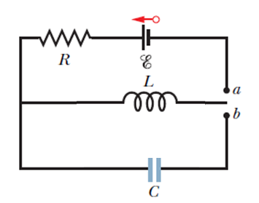
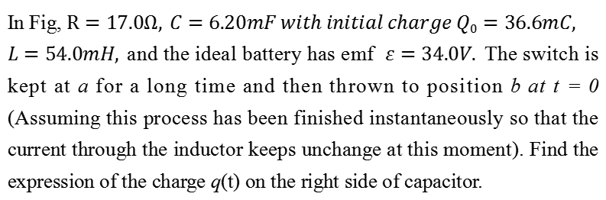


Problem 1
In Fig, $R=17.0Ω, C=6.20mF with initial charge Q0=36.6mC,$
$L=54.0mH,$and the ideal battery has emf $ε=34.0V.$The switch is kept at a for a long time and then thrown to position b at t = 0 (Assuming this process has been finished instantaneously so that the current through the inductor keeps unchange at this moment). Find the expression of the charge q(t) on the right side of capacitor.
$$+Q0$$
$$−Q0$$
Ch31-7

Slide 4



Answers
For the LC oscillating circuit, q on the right side of C is
$$q\left(t\right)=Qcos(ωt+φ)$$
And the corresponding i (clockwise) is
$$i\left(t\right)=\frac{dq}{dt}=−ωQsin(ωt+φ)$$
$$+Q0$$
$$−Q0$$
The switch is kept at a for a long time and then thrown to position b at t = 0, that
means the initial current for the oscillating LC circuit is clockwise with magnitude:
$$i\left(t=0\right)=i0=\frac{ε}{R}=−ωQsin\left(φ\right) (1)$$
$C=6.20mF with initial charge Q0=36.6mC$ as shown in the figure, we can get the initial charge on the right side of C is:
$$q\left(t=0\right)=−Q0=Qcos\left(φ\right) (2)$$
Ch31-8

Slide 5
Answers
The angular frequency is:
(1)+(2), we obtain:
From the conservation of energy, we obtain:
So the expression of the charge q(t) on the right side of capacitor:
Ch31-9

Slide 6
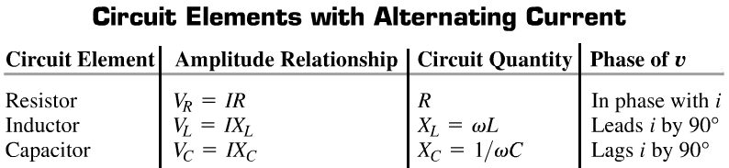
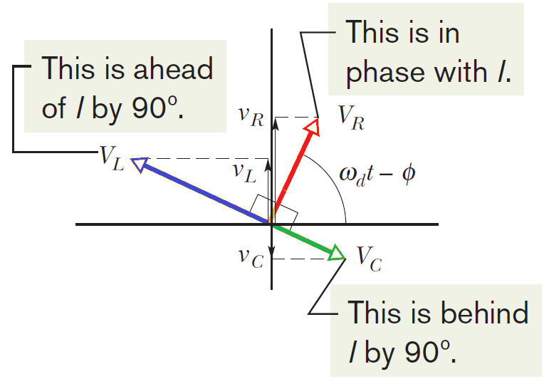
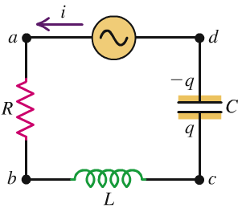
Review of Ch31
Series RLC circuit
Ch31-3
Notes:
We use phasor to describe the time-varying quantities, phasors are vectors that rotate around an origin, for example, this is a phasor

Slide 7
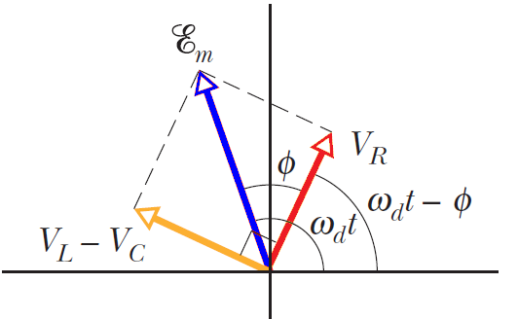


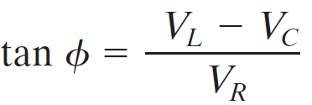
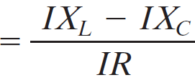
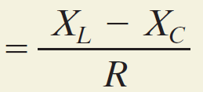
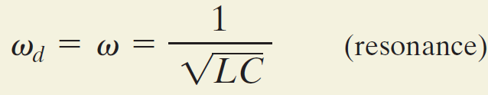

Review of Ch31
Series RLC circuit—force oscillator
v_{R} + v_{C} + v_{L} = ε
→ V_{R}² + ( V_{L} - V_{C} )² = ξ_{m} ²
(IR)² + ( I X_{L} – I X_{C} )² = ξ_{m} ²
m
Z : Impedance
Phase constant (angle) :
Resonance:
Ch31-4

Slide 8

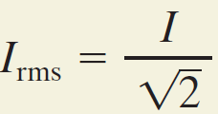
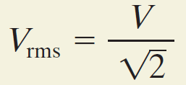
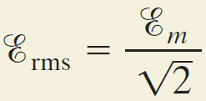
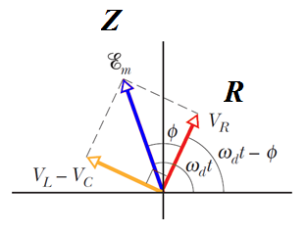
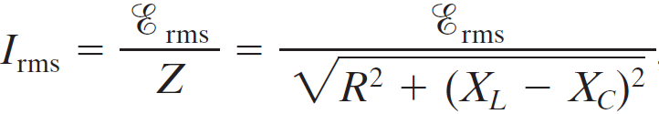


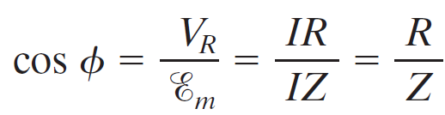
Review of Ch31
Power in AC circuit
In DC circuit : Power = i²R
In AC circuit :
The value shown in multimeter(万用表) is the rms value
Power factor:
Ch31-5

Slide 9
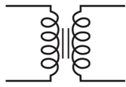
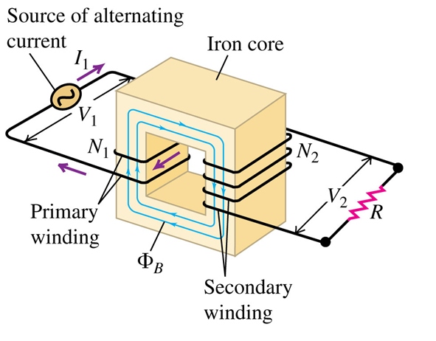





Review of Ch31
Transformers
Φ_{B} is the same for each turn of the primary and secondary windings
By conservation of energy :
put in:
and
The value of load resistance seen by the generator
we have
Ch31-6

Slide 10
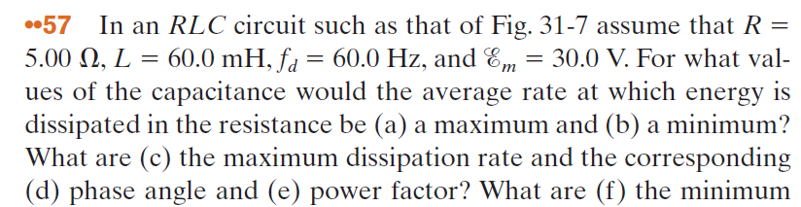
Problem 2
Ch31-10

Slide 11
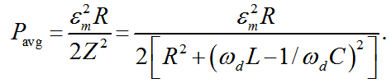


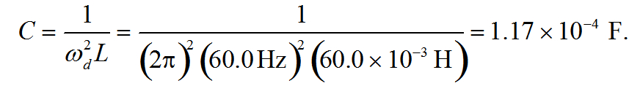

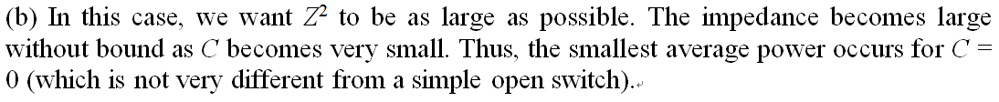

Answers
Ch31-11

Slide 12
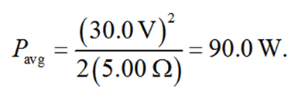


Answers
Ch31-12

